Slide 1
Tips & Tricks: Adding Equations to MS Office Documents
Enhancing reports and instructional materials
with professional looking formulas

Slide 2
Unicode LaTeX
x=12
10 <= x \le [space] 12 , x \ne [space] 0
2 \div [space] 3=2 / 3 [space] = 2 \ / 3
2+3 / 4+5 \ne ( 2+3 ) / ( 4+5 )
2 ^ 10 =1024
x=12
10 \le x \le 12, x \ne 0
2\div 3=\frac{2}{3}=2/3
2+3 / 4+5 \ne \frac{2+3}{4+5}
2 ^{10} =1024

Slide 3
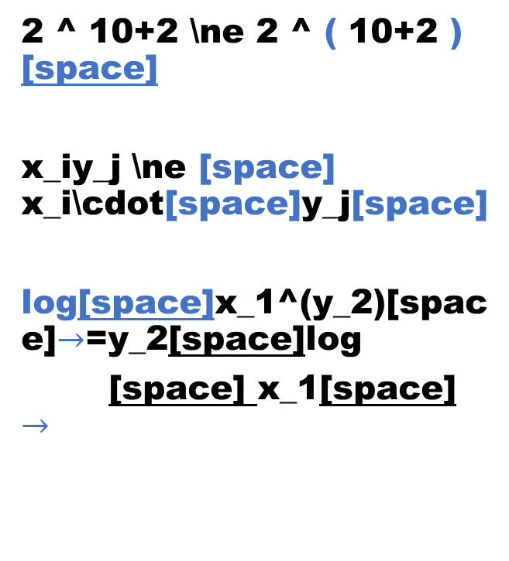
Unicode LaTeX
2 ^ 10+2 \ne 2 ^ ( 10+2 ) [space]
x_iy_j \ne [space] x_i\cdot[space]y_j[space]
log[space]x_1^(y_2)[space]$→$=y_2[space]log
[space] x_1[space] $→$
2 ^ {10}+2 \ne 2 ^ {10+2}
x_{iy_j} \ne x_i \cdot y_j
\log {x_1^{y_2}} = y_2 log{x_1}

Slide 4
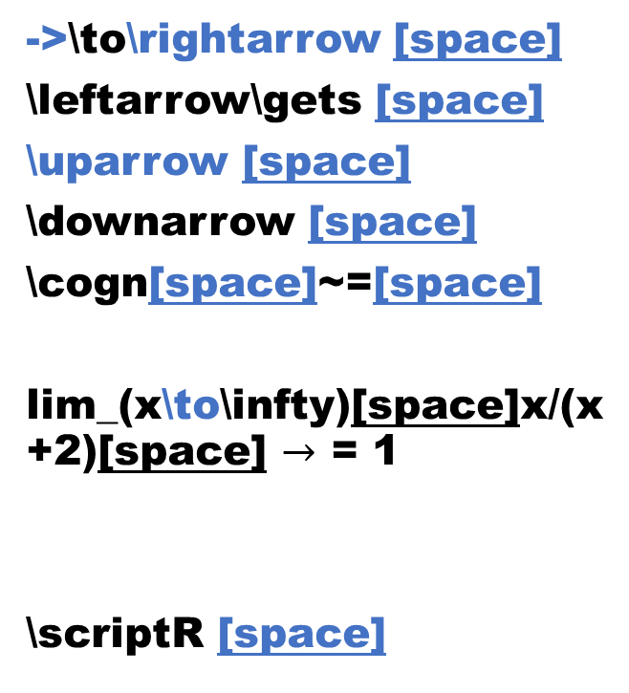
Unicode LaTeX
->\to\rightarrow [space]
\leftarrow\gets [space]
\uparrow [space]
\downarrow [space]
\cogn[space]~=[space]
lim_(x\to\infty)[space]x/(x+2)[space] $→$ = 1
\scriptR [space]
\rightarrow
\leftarrow \gets
\uparrow
\downarrow
\cogn
\lim_{x\to \infty} \frac{x}{x+2}=1
\underset{x\to \infty}{\lim} \frac{x}{x+2}=1
\mathcal{R}

Slide 5
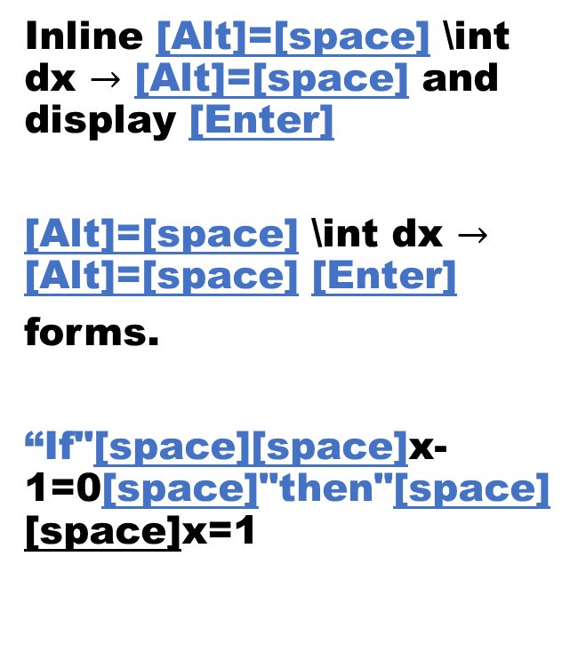
Unicode LaTeX
Inline [Alt]=[space] \int dx $→$ [Alt]=[space] and display [Enter]
[Alt]=[space] \int dx $→$ [Alt]=[space] [Enter]
forms.
“If"[space][space]x-1=0[space]"then"[space][space]x=1
Inline $\int dx$ and display $$\int dx$$ forms.
Inline \(\int dx\) and display \[\int dx\] forms.
\text{If[space]} x-1=0 \text{[space]then[space]}x=1

Slide 6
Unicode LaTeX
a\thicksp[space] b \thinsp [space] c \medsp dx
a+2(b-a)=a+\hphantom(2(b-a))=2b-a
a+2(\phantom(\int_0^1 [space] dx→)) =c
a\hspace{.3em}b\hspace{.15em}c\hspace{.2em}dx
a\;b\,c\:dx
a+2(b-a)=a+\hphantom{2(b-a)}=2b-a
a+2\left(\phantom{\int_0^1 dx}\right)=c

Slide 7
Unicode LaTeX
\eqarray(x−z&=12@−3x−2y+100z&=18)[space]
\eqarray(x&&&&-z&=12@-3x&&-2y&&+100z&=18)[space]
\pmatrix(1&2+3@2+5&6)[space]
In display ($$...$$)
\begin{align*}
x-z&=12\\-3x-2y+100z&=18
\end{align*}
\begin{align*}
x&&&&-z&=12\\
-3x&&-2y&&+100z&=18
\end{align*}
\pmatrix{1&2+3\\2+5&6}
In display ($$...$$)

